Slide 1
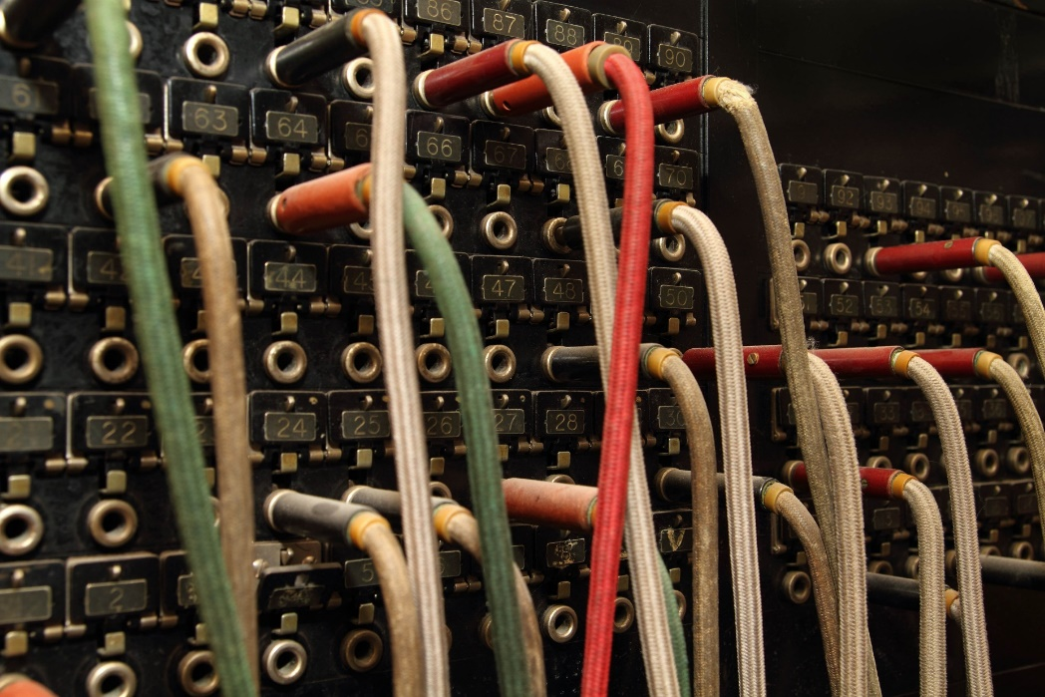
TCP
Socket
ServerSocket
Byte Streams

Slide 2
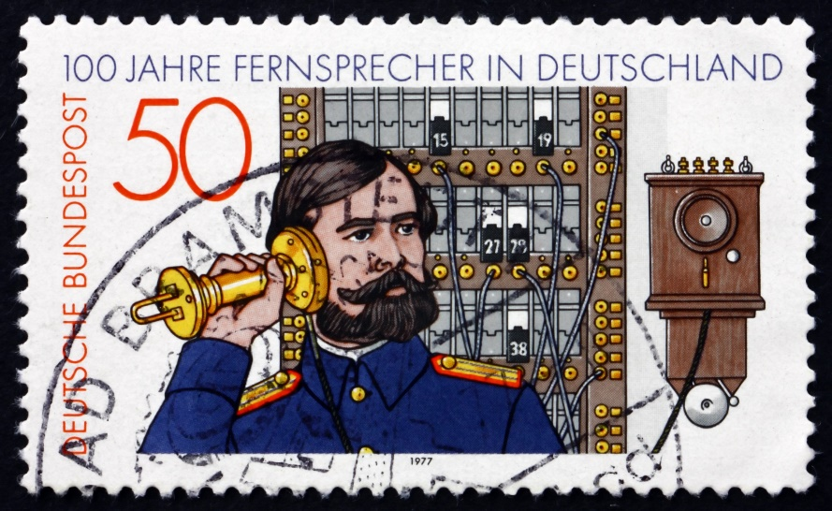
See Also
https://docs.oracle.com/javase/tutorial/networking/sockets
http://cs.lmu.edu/~ray/notes/javanetexamples/

Slide 3
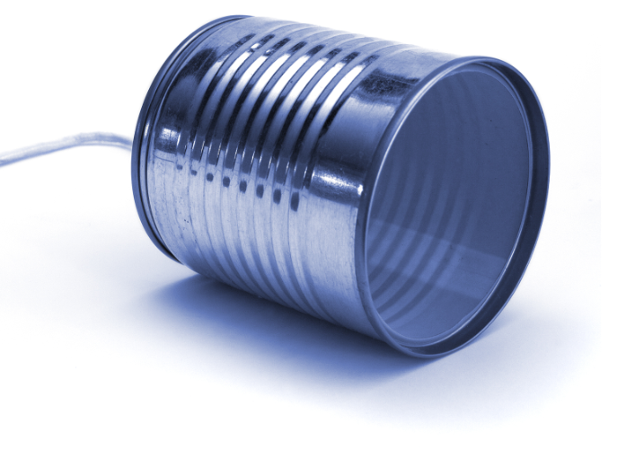
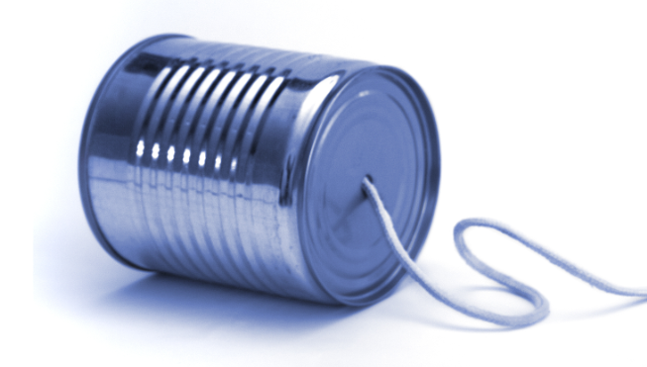
The ServerSocket
This is Port 80. One Second Please ...
2.4.3.3:80
ServerSocket
10.10.2.1:2755
Socket
accept()
10.10.2.1:3038
2.4.3.3:80
Socket
Socket
2.4.3.3:80
Socket
The OS buffers the connections as they come in
You must call “accept” to take an incoming connection
RemoteAddress/Port, LocalAddress/Port will be unique
Streams of bytes … two ways (into your program and out of your program)
Disks, consoles, sockets, keyboards, printers
Know how to talk streams and you can talk to anything
Initialization (constructor) is different. Use is the same.

Slide 4

Sockets
Streams of bytes … two ways (into your program and out of your program)
Disks, consoles, sockets, keyboards, printers
Know how to talk streams and you can talk to anything
Initialization (constructor) is different. Use is the same.

Slide 5

Tinkering
Type in the Left/Right example and send some bytes back and forth.
Try timing the “write” with and without flushing at the client. Does flushing make a difference here? Why or why not?
Notes:
Reference the discussion area

